Slide 1
What is OOPS

Slide 2
What are four pillars of OOP?
Abstraction
Encapsulation
Inheritance
Polymorphism

Slide 3
Abstraction
Essential information required to identify any object with out its detail. Information can be attribute or action or both.
Or
The process of formulating general concepts by abstracting common properties of instances.

Slide 4
Encapsulation
Encapsulation is mechanism to achieve abstraction

Slide 5
Inheritance
Any attribute or immaterial possession that is inherited from ancestors

Slide 6
Polymorphism
polymorphism (from the Greek meaning "having multiple forms") is the characteristic of being able to assign a different meaning or usage to something in different contexts

Slide 9
Generalization Vs Specialization
Shape
Square
Circle
Triangle
Generalization
Specialization by Implementation

Slide 10
Generalization Vs Specialization
Shape
Square
Circle
Triangle
Generalization
Specialization by realization

Slide 11
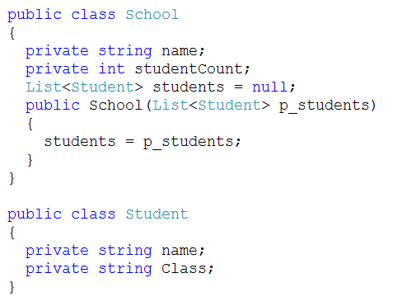
Aggregation

Slide 12
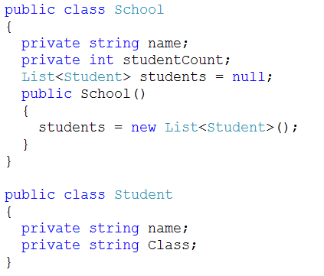
Composition (Has a relationship)

Slide 13
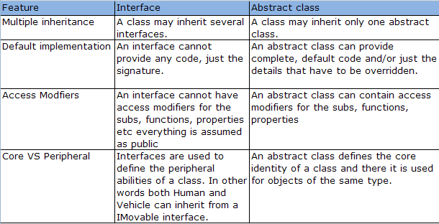
When to use interface and when to use abstract class?

Slide 14
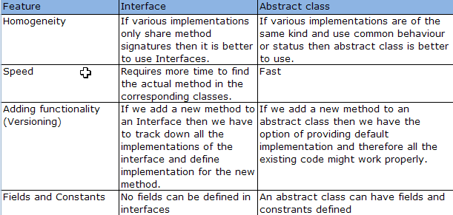

Slide 15
Design Principle
Class Cohesion
Open-Closed
Single Responsibility
Interface Segregation
Dependency Inversion
Liskov Substitution
Law of Demeter
Reused Abstractions

Slide 16
Class Cohesion
Class design should reduce the need to edit multiple classes when making changes to application logic. A fundamental goal of OO design is to place the behavior (methods) as close to the data they operate on (attributes) as possible, so that changes are less likely to propagate across multiple classes

Slide 17
Open-Closed
Once a class is tested and working, modifying its code can introduce new bugs. We avoid this by extending the class, leaving its code unchanged, to add new behavior. Classes should be open to extension, but closed to modification

Slide 18
Single Responsibility
Changing code in a tested class can introduce new bugs. We seek to minimize the reasons why a class might need to change. The more different things a class does, the more reasons it might have to change.

Slide 19
Interface Segregation
If different clients depend on different methods of the same class, then a change to one method might require a recompile and redeployment of other clients who use different methods. Creating several client-specific interfaces, one for each type of client, with the methods that type of client requires, reduces this problem significantly.

Slide 20
Dependency Inversion
Much of the duplication in code comes from client objects knowing about all sorts of specialized suppliers, that from the clients perspective do similar things but in different ways. Polymorphism is a powerful mechanism that underpins OO design. It allows us to bind to an abstraction, and then we don’t need to know what concrete classes we are collaborating with. This makes it much easier to plug in new components with no need to change the client code.

Slide 21
Liskov Substitution
Dynamic polymorphism is a powerful mechanism that allows us to invert dependencies, reducing duplication and making change much easier. All OO design principles depend upon polymorphism, but we must ensure that any type can be substituted for any of its subtypes at run-time without having any adverse effect on the client. Subtypes must obey all of the rules that apply to their super-types pre-conditions for calling methods, post-conditions of methods called, and invariants that always apply between method calls.

Slide 22

Common design patterns
Creational Patterns
Factory Method
Abstract Factory
Builder
Singleton
Structural Patterns
Adapter
Behavioral Patterns
Observer
Iterator
Others
MVP
DI

Slide 23
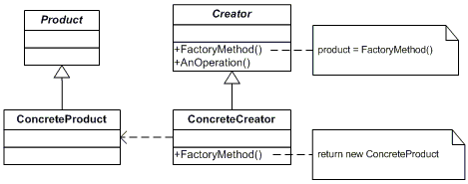
Factory pattern
Define an interface for creating an object, but let subclasses decide which class to instantiate. Factory Method lets a class defer instantiation to subclasses.

Slide 24
Code (factory Pattern)

Slide 25
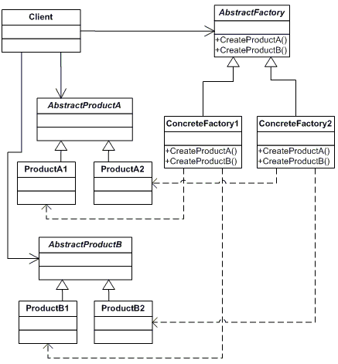
Abstract Factory
Provide an interface for creating families of related or dependent Objects without specifying their concrete classes.

Slide 26
Code(Abstract factory)

